Slide 1
Introduction to Big-Data
Lecture-0

Slide 2
What do we think about data and big data??
Why we should know about them?

Slide 3
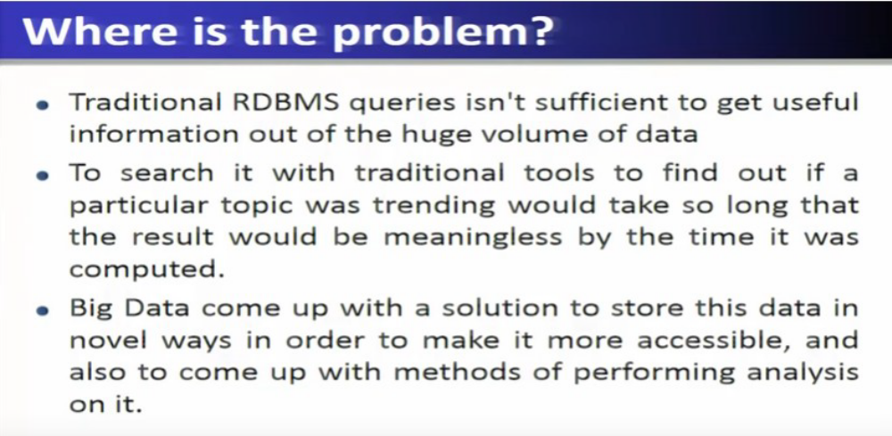


Slide 4
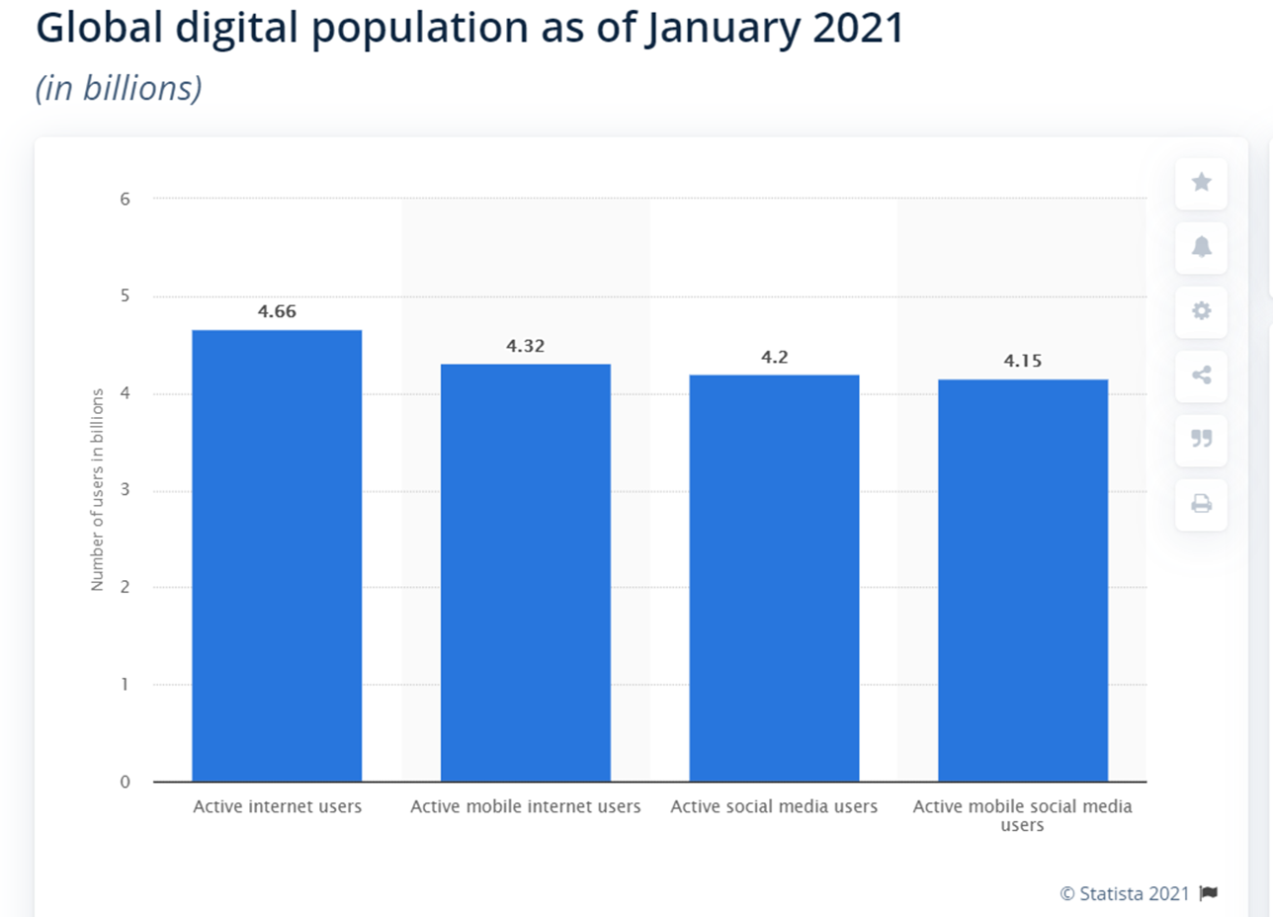
Some Statistics – From where Big Data comes
All these users generate massive data in
every second.
Facebook generates 4 new petabytes of data per day.
Facebook now sees 100 million hours of daily video
watch time.
Users generate 4 million likes every minute.
On an average 350 million photos per day are being
uploaded every single day.
https://www.brandwatch.com/blog/facebook-statistics/ [2019]
https://www.statista.com/statistics/617136/digital-population-worldwide/

Slide 5
Some Statistics – From where Big Data comes-II
Estimation - Google processes approximately 63,000 search queries every second,
translating to 5.6 billion searches per day [When Google opened its proverbial doors in
September 1998, it only averaged about 10,000 daily search queries.] and
approximately 2 trillion global searches per year.
There are now more than 1.8 billion Gmail users worldwide. (TechJury)
In 2021, there are approximately 1.86 billion YouTube users.
Five hundred minutes of video uploaded to YouTube every minute
= approximately 30,000 hours of video uploaded every hour. [The number of video content
hours uploaded to YouTube every 60 seconds grew by 40% between 2014 and 2019.]
https://blog.hubspot.com/marketing/google-search-statistics
https://www.semrush.com/blog/youtube-stats/

Slide 6
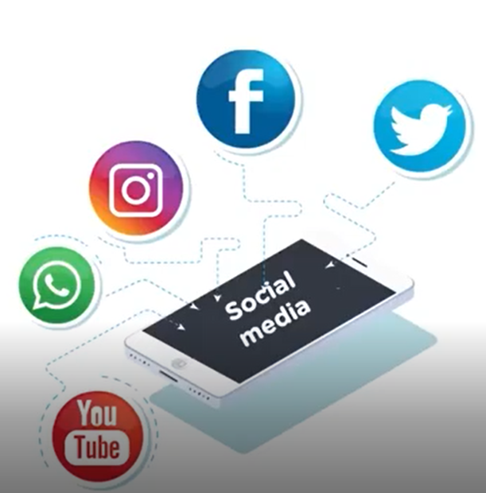
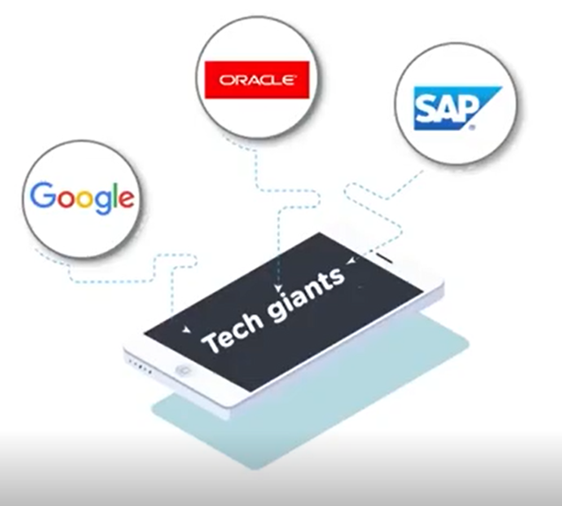
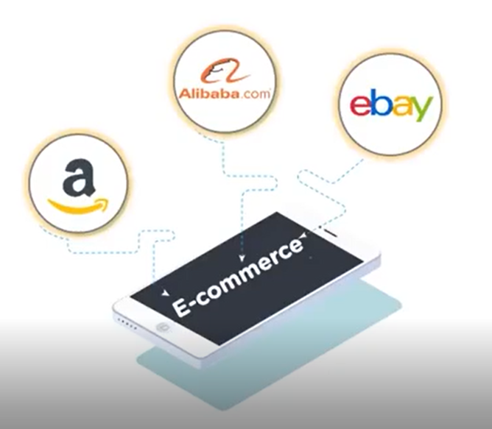
PC: Simplilearn
All these data collectively termed as “Big Data”.

Slide 7
What makes possible “The era of Big Data”
Data Science #1 catalyst for Economic growth – McKinsey [2013]
1. Massive Data continuously coming from global digital population.
40 % projected growth in data generated/year versus 5% growth in IT spending.
2. Cloud Computing – computation any where any time.
Torrent of Data + Scalable, dynamic analysis Era of Big Data

Slide 8
Why Big Data is so important?
Examples – to show that processing and analyzing Big Data provides better model that
allows for high precision recommendation or solutions to make the world better place.
Big Data
Better Models
Higher Precision
Right Decision
Examples : Marketing Strategy, Human resource managements, Disaster managements, Health care.

Slide 9
Personalized Marketing
Big Data
You are looking for a product in Amazon.
Amazon keeps that data.
Based on your search, Amazon shows you the options
for that product only.
Awesome !! That’s it what I was looking for.
Big Data analysis helps Amazon to
narrow down the huge raft of options you might get.
Personalized marketing
Happy Customers
Big Data enables to hear the voice of each individual customer as opposed to
collective consumers.

Slide 10
Personalized Marketing-II
Consumers like us consistently generate ( e.g.- Like, Share, Retweet, Subscribe) publicly
accessible data through social media sites.
Companies are able see the purchase history, search history, what they watched, real time
location status, what they are interested in.
Companies put all these information to build better marketing campaign to reach the
right customers.
Example : YouTube, Netflix recommend you the videos/movies/web series based on your
watch history.
Mobile advertising – based on sensors such as GPS – real time location based adv., offer discount.

Slide 11
Collective consumer behaviours
Companies often need to understand consumers’ collective behaviour to capture ever-changing
Land-scape Target right audiences for their product or develop new product for uncharted
territories.
Depart | Arrive | Flight no. | Routing | Travel time | Business Sell ($276) | Anytime ($254)
6:20 am | 8:00 am | 2453 | Non-stop | 1 h 40 m | Sold out | $254
7:45 am | 9:15 am | 2292 | Non-stop | 1 h 30 m | Sold out | $254
10:10 am | 11:40 am | 1538 | Non-stop | 1 h 30 m | Sold out | $254
12:25 pm | 1:55 pm | 476 | Non-stop | 1 h 30 m | $276 | $254
2:05 pm | 1:35 pm | 340 | Non-stop | 1 h 30 m | $276 | $254
Morning flights always sold out whereas afternoon flight runs below capacity.

Slide 12
Collective consumer behaviours - II
Big Data analysis – consider all the flight purchases rather than considering individual
consumer choices.
Decision the flight company may take-
Add more morning flights.
Closer attention to the demographics of these consumers.
Also add similar morning flights to other geographical regions.
Other applications 1 – genome sequencing technology – Bio-medical Big Data –
Personalized treatment –tailor a specific treatment to individual based on genome
Sequence.
By 2025, 100 million – 2 billion human genome can be sequenced, which will generate
2 – 40 exabytes data-storage (currently, YouTube requires 1 – 2 exabytes of data storage
in a year) – 10,000 trillion CPU hours to process such huge volume of data.

Slide 13
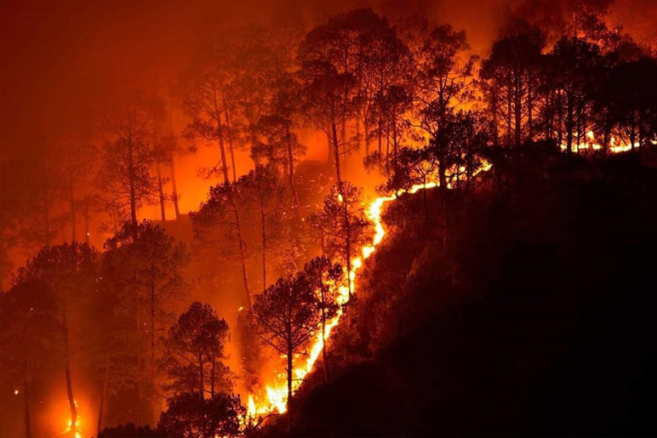
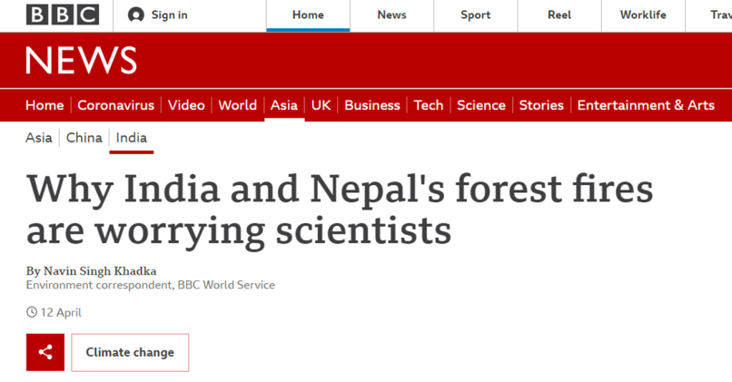
Other applications 2 – Wildfire prevention and management
In recent years India has faced several devastating wild-fires
2019 Bandipur forest fires [source: https://en.wikipedia.org/wiki/2019_Bandipur_forest_fires]
Uttarakhand forest fire in October 2020 [source: https://www.downtoearth.org.in
/video/climate-change/still-burning-forest-fires-continue-to-rage-in-uttarakhand-76487]
Mizoram forest fire in April 2021 [source: https://www.downtoearth.org.in/video/
environment/massive-forest-fire-in-mizoram-76694]
Nearly 20 people have been reportedly killed by the fires in Uttarakhand
and Nepal.
Hundreds and thousands of hectors of forests are destroyed.
0.2 Megaton of carbon emissions !
We cannot control firestorm, but what we can do – get ahead of them to predict
their behaviour (Understanding their direction and rate of spread).
Integrate
Sensors & Satellites: Measure environmental factors
Organizations: Area maps, field contents data bases – vegetations and fuels
How Big Data
can help :
People

Slide 14
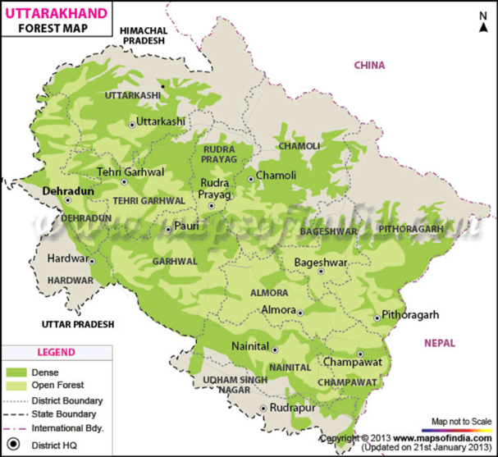
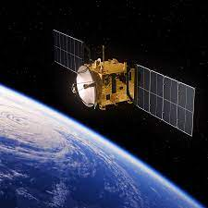
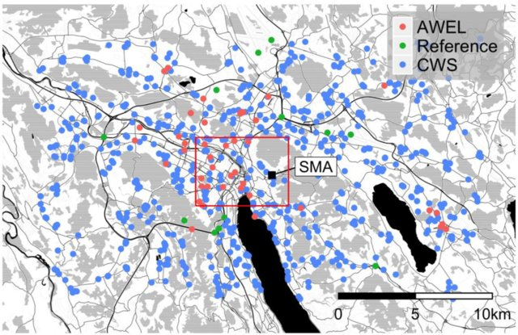

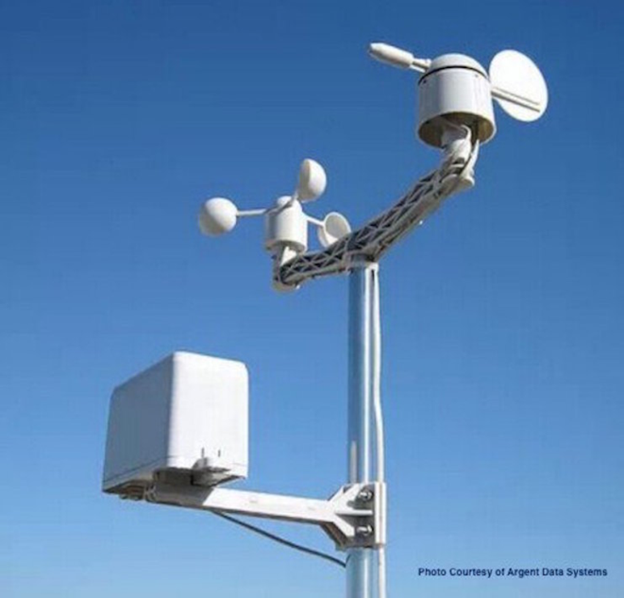
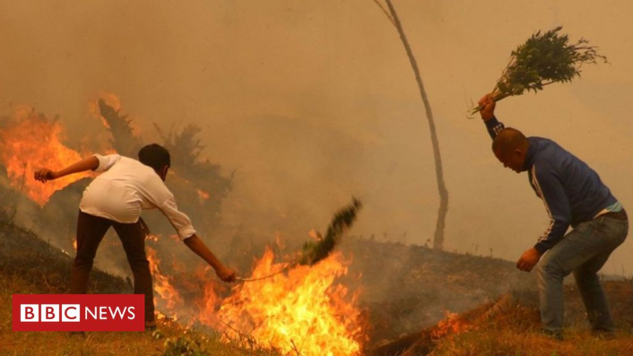
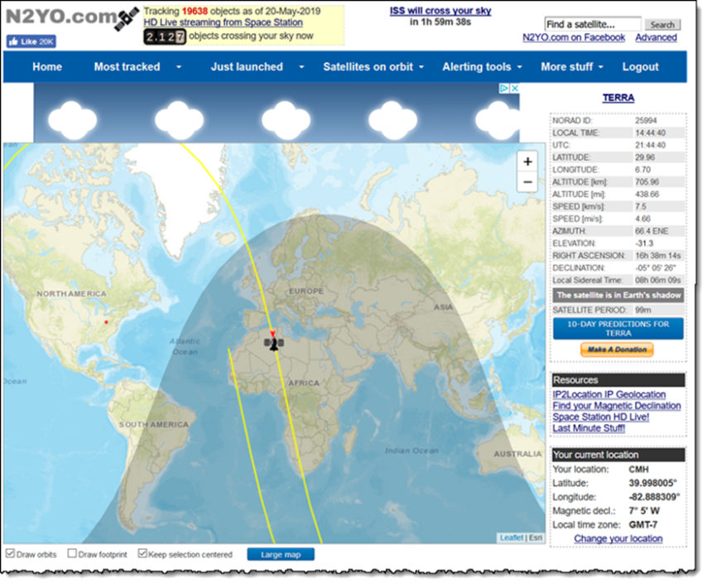
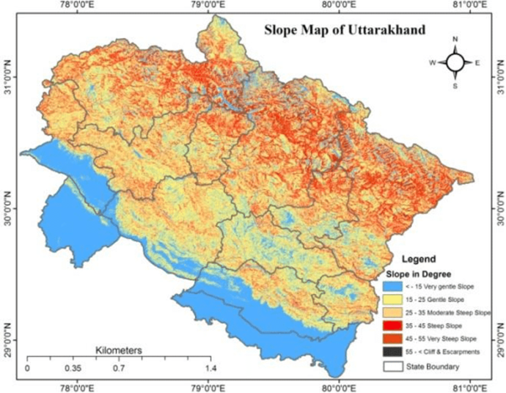
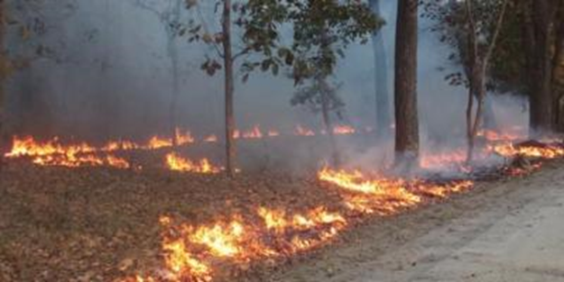
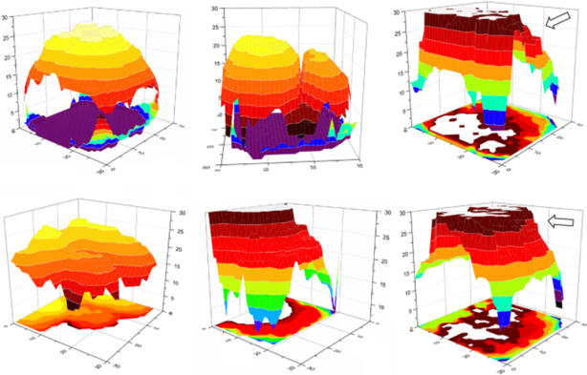
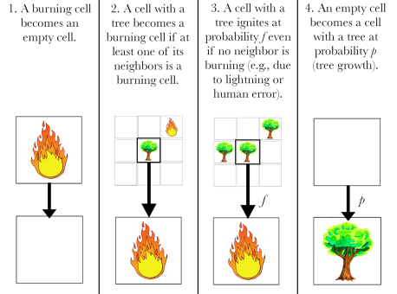
Integrate diverse data streaming
Machine Data:
Organizational Data:
People Data:

Slide 15
Course Content
Unit1: The fundamentals of Big Data
Unit2: Business motivations and drivers for Big Data Adoption
Unit3: Big Data Adoption and Considerations
Unit4: Big Data Storage Concepts
Unit5: Big Data Processing Concepts
Unit6: Big Data Planning Considerations

Slide 16
Books and Materials
BIG DATA SIMPLIFIED, SOURABH MUKHERJEE SAYAN GOSWAMI AMIT KUMAR DAS, Pearson
BIG DATA, BLACK BOOK, DT EDITORIAL SERVICES, DREAMTECH PRESS
https://www.tutorialspoint.com/big_data_analytics/big_data_analytics_lifecycle.htm
https://www.tutorialspoint.com/big_data_analytics/index.htm

Slide 17
Summary
Massive data (exabyte, zettabyte) generated every second at a massive pace.
Capturing, storing and processing this huge data require infrastructures like cloud computing,
parallel processing in commodity clusters which was not previously available.
Hence, the companies were not able to work with all the data in previous years.
Now, they are realizing it is important to work with all the data to find hidden pattern which
enables to decide important business strategy.
Applications – Business, Healthcare, Disaster management, Crime prevention and many more.

